Slide 1
The Forest Bioeconomy in the EU
Embassy of Finland & EU Delegation to the US Webinar on
The Role of Forest Bioeconomy in the Green Economy Transition
Creating a Business Case and Catalyzing Green Growth in a Sustainable Forest Bioeconomy
27 May 2020, Peter Wehrheim
European Commission, Brussels DG Research & Innovation
Bioeconomy & Food Systems Unit

Slide 2
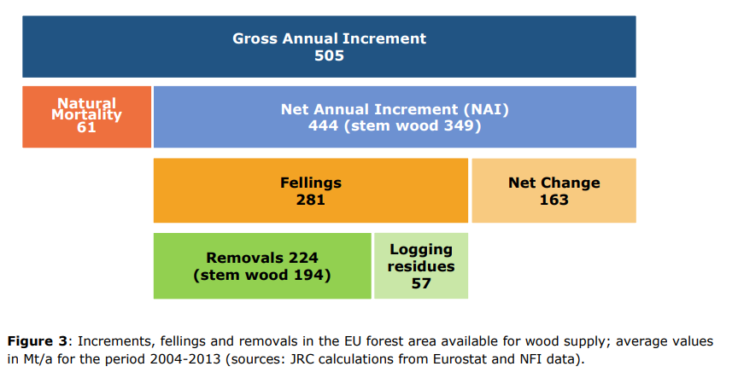
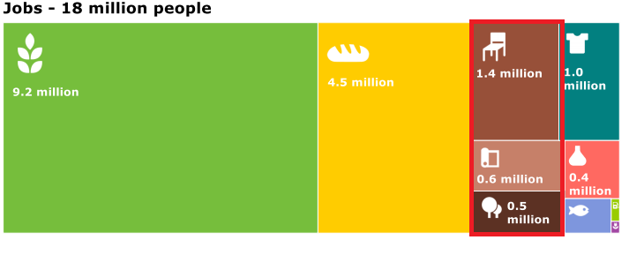
Forests and forest value chain in the EU - facts
Forests cover 161 Mha of the EU area, accounting for 38% of the total land surface
Net annual increment – 444 Mt/a, out of which 281 Mt is felled annually → harvest intensity of 63% (likely to be underestimated due to underreporting of harvest)
EU roundwood production - 490 million m3 in 2018 (Source: Eurostat)
23% used directly as fuelwood
210 mil m3 saw mill industry
158 mil m3 pulp industry
Jobs and economy
2,6-3 mil people employed in the forest value chain (Source: JRC 2015)
Gross Vaue Added of wood-based industries was EUR 129 billion or 7.1 % of the total manufacturing industry in 2018 (Source: Eurostat)

Slide 3
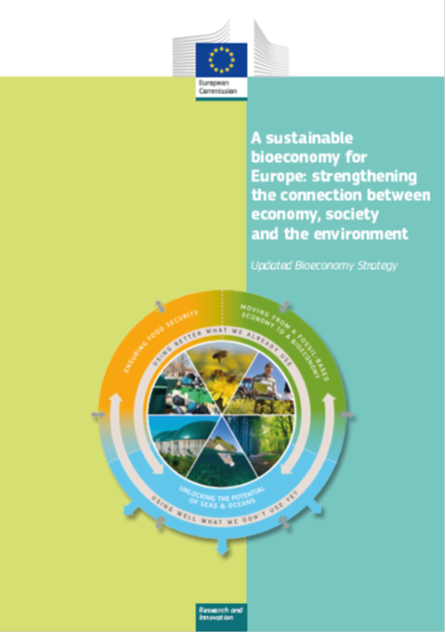
A sustainable bioeconomy for Europe: Strengthening the connection between economy, society and the environment in the EU
…was developed with involvement of different thematic Directorates (Research, Agriculture, Environment, MARE, GROW).
The 2018 updated Bioeconomy Strategy aims to:
Link the sustainable use of renewable biological resources for food, feed, bio-based products and bioenergy, with the protection and restoration of biodiversity, ecosystems and natural capital across land and water.
Step up action to ensure that the Bioeconomy provides a long-term balance of social, environmental and economic gains.

Slide 4
Key features of the updated strategy
A SYSTEM-wide approach, delivering on policies across sectors, addressing trade-offs
A strong focus on SUSTAINABILITY and CIRCULARITY
Delivering for the citizens - on jobs, sustainable growth, well being - in particular in rural areas
A set of well-defined actions including:
on scaling up research and innovation for the development of substitutes for fossil-based materials, scaling up the bio-based sectors (chemicals, textiles, liquid biofuels), take stock of regulatory gaps/bottlenecks that hamper start-ups, promote standards (based on LCA) or market-based incentives, advocate Green Public Procurement, education etc. (Bioeconomy Universities)
https://european-bioeconomy-university.eu/alliance/

Slide 5
The European Green Deal
Designing a set of
deeply transformative policies
Mainstreaming
sustainability in all EU policies
Transforming the EU’s economy for a sustainable future
Increasing the EU’s Climate ambition for 2030 and 2050
A zero pollution ambition
for a toxic-free environment
The
European Green Deal
Supplying clean, affordable and secure energy
Preserving and restoring ecosystems and biodiversity
Mobilising industry
for a clean and circular economy
From ‘Farm to Fork’: a fair, healthy and environmentally friendly food system
And leaving
no one behind
Building and renovating in an energy and resource efficient way
Accelerating the shift to sustainable and smart mobility
Leave no one behind (Just Transition)
The EU as a global leader
A European Climate Pact
Financing the transition
Notes:
Make the EU climate-neutral by 2050
Enable us to produce, move, consume and live in a more environmentally-responsible way
Cleaner energy and green technologies
Truly circular economy
Protecting biodiversity
A transition that is just and socially fair

Slide 6
The European Green Deal
Forest bioeconomy role in the EGD:
Increasing the EU’s Climate ambition for 2030 and 2050
Maintenance and enhancement of carbon sink
Wood as renewable energy source if meeting sustainability criteria (REDII)
Circular forest-based economy (CBE Partnership, HE research funding)
Potential for wood as construction material with low production emissions and high carbon storage
Protection and restoration of forests as a goal of the Biodiversity Strategy
A zero pollution ambition
for a toxic-free environment
Supplying clean, affordable and secure energy
The
European Green Deal
Preserving and restoring ecosystems and biodiversity
Mobilising industry for a clean and circular economy
From ‘Farm to Fork’: a fair, healthy and environmentally friendly food system
Building and renovating in an energy & resource efficient way
Accelerating the shift to sustainable and smart mobility

Slide 7
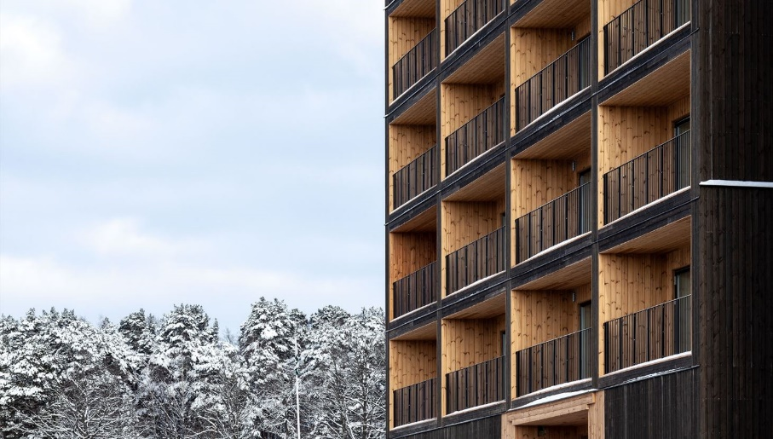
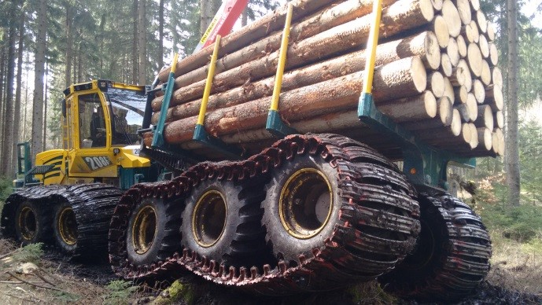
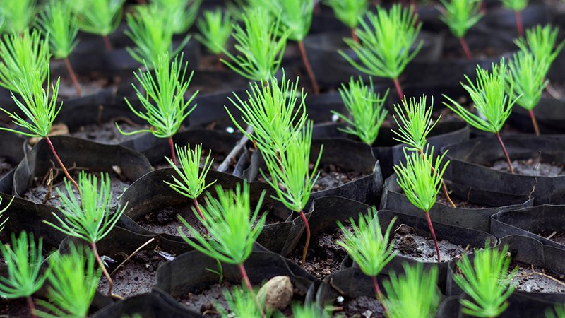
Examples of forest–based industry research and innovation in action
Multi-storey wood buildings
Build-in-Wood
Sustainable and efficient forwarders
Forwarder2020
Sustainable supply and payment for forest ecosystem services
InnoForESt
Adaptive breeding for productive resilient forests under climate change
B4EST
Notes:
Build in Wood: The project will develop sustainable and innovative materials and components as well as structural systems for the construction of multi-storey wood buildings.
Forwarder2020: the Hohenlohe Spezial Maschinenbau (HSM) together with 12 EU partners developed a forwarder with lower fuel consumption and reduced impact on forest soils, therefore improving sustainability of wood harvesting and transporting.
InnoForESt: The project will facilitate the transfer and up-scaling of existing niche governance models to demonstrate the feasibility of alternative income streams from a diverse set forest ecosystem services (CO2 sequestration, biodiversity etc).
B4EST: The project will provide forest tree breeders with new and flexible adaptive tree breeding strategies and forest managers and owners with new tree genotypes of highly adaptive and economical value

Slide 8
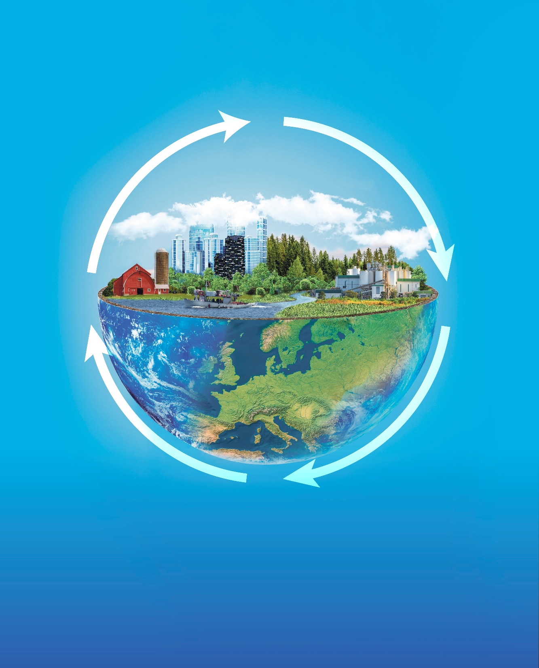
Thank you
http://ec.europa.eu/research/bioeconomy
© European Union 2020
Unless otherwise noted the reuse of this presentation is authorised under the CC BY 4.0 license. For any use or reproduction of elements that are not owned by the EU, permission may need to be sought directly from the respective right holders.

