Slide 1
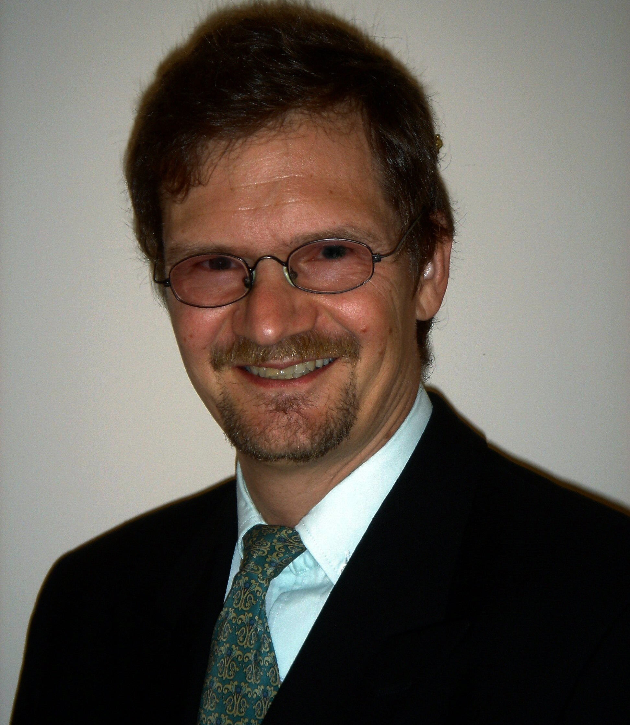
Pekka Voutilainen
Ambassador
Embassy of Finland
Doha, Qatar
Mr. Pekka Voutilainen is the Ambassador of the Republic of Finland to the State of Qatar since January 2022 and non-resident Ambassador to the State of Kuwait.
Before his current position he has served as Ambassador for Trade and Development at the Ministry for Foreign Affairs. Earlier he has served as the Ambassador of Finland to Saudi Arabia in Riyadh (2014-2018) and non-resident Ambassador to Kuwait, Oman and Yemen. He also served as a Head of Mission at the Embassy of Finland in Ankara, Turkey. Previously in his career Mr. Voutilainen has served also in Austria, Thailand, India, France and in the United States.
Mr. Voutilainen has a Master of Laws degree from the University of Lapland. He has also studied at the University of Helsinki.
Mr. Voutilainen is married with two adult children. He was born in 1960.
In his free time he plays football, tennis and golf.

